Slide 1



Slide 2
Contents
1
Binary Tree
2
Searching
3
Max & Min
4
Starting State Space Searching

Slide 3
Trees
A tree is a two-dimensional linked structure
When do you encounter trees in real-life?

Slide 4
Trees
A tree is a non-empty collection of vertices (node) and edges (connection)
A path in a tree is a list of distinct vertices in which successive vertices are connected by edges in a tree
One node is designated as the root

Slide 5
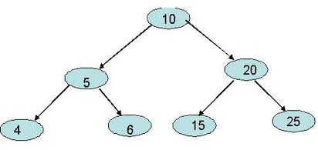
Binary Tree
One of the simplest types of tree is a binary tree

Slide 6

What does a tree node look like?
A tree can be represented by a linked data structure

Slide 7
How can a tree be searched?
I want to search for the node which has 6

Slide 8
How can a tree be searched?
TreeSearch(x, k)
while x<> NIL and k<>x.key
if k<x.key
x = x.left
else
x=x.right
return x

Slide 9
Minimum & Maximum
The binary-search-tree property guarantees that
  the minimum key of a binary search tree is located at the leftmost node
  maximum key of a binary search tree is located at the rightmost node
Traverse the appropriate pointers (left or right) until NIL is reached.

Slide 10
What is the minimum value in this tree?
Write the algorithm for this

Slide 11
What is the minimum value in this tree?
TreeMinimum(x)
while x.left<>NIL
x = x.left
return x

Slide 12
What is the maximum value in this tree?
Write the algorithm for this

Slide 13
What is the maximum value in this tree?
TreeMaximum(x)
while x.right<>NIL
x = x.right
return x

Slide 14
Minimum & Maximum
Write a recursive version of:
  TreeMinimum
  TreeMaximum

Slide 15
State Space Searching

Slide 16
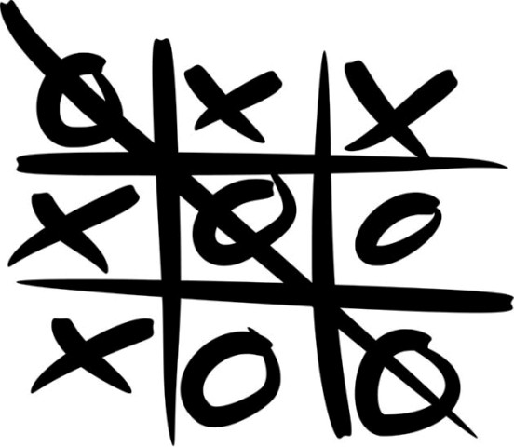
How can I win at Tic-Tac-Toe?

Slide 17
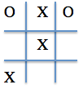
What are the choices for O’s next move? Write it down in tree-form

Slide 18
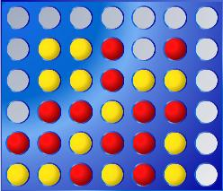
How can I win at Connect 4?

Slide 19
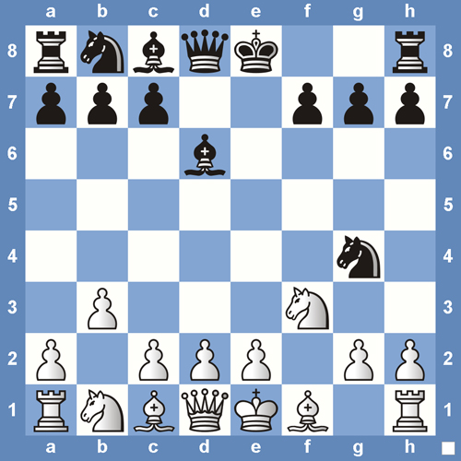
How can I win at Chess?

Slide 20
A Solution ….
Us an Artificial Intelligence (AI) technique:
  State Space Search

Slide 21
Thank You !

